Slide 1
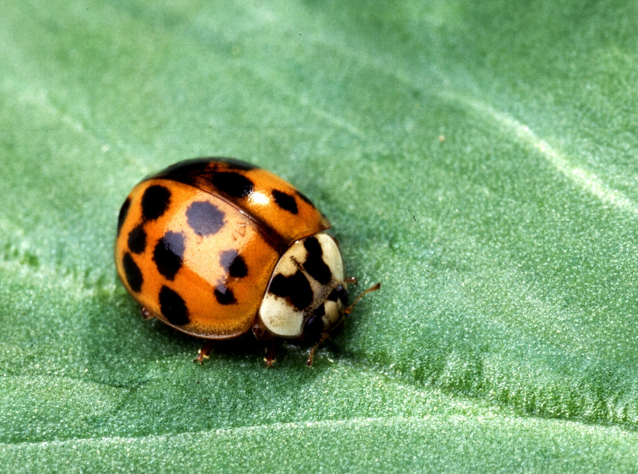


Commercial Biological Control and Integrated Pest Management
Norm Leppla
UF, IFAS, IPM Florida

Slide 2
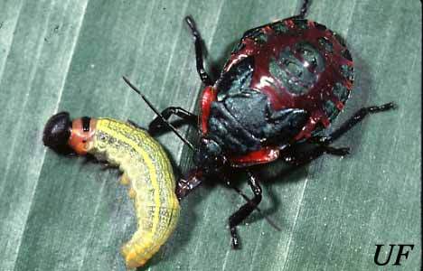
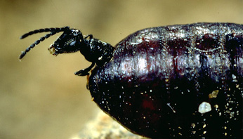
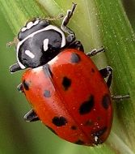
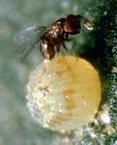
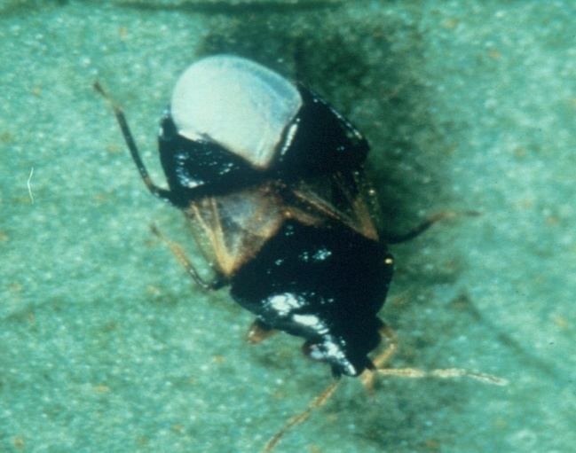
Major Commercial Natural Enemies

Slide 3
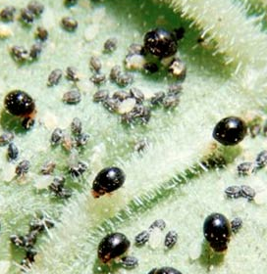
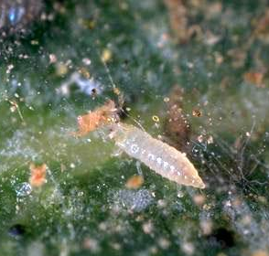
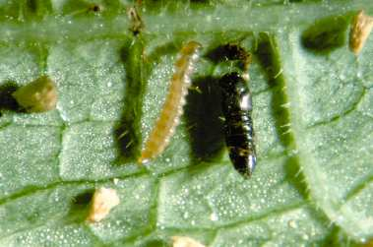
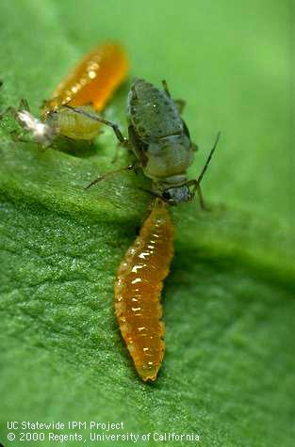
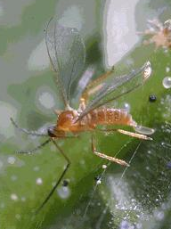
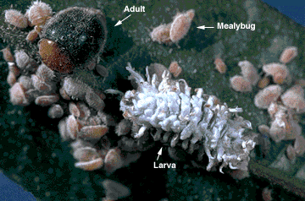
Major Commercial Natural Enemies

Slide 4
Milestones in Commercialization of Biological Control
1895- Farming Trichogramma proposed
1926- Fillmore, mass prod. NE citrus pests
1929- Trichogramma on factitious host
1949- Chrysoperla colonization
1956- Predaceous mites, mites on strawberry
1968- Koppert established
1975- Trichogramma, European corn borer
1981- IOBC WGQC (AMRQC)
1988- Whitefly parasites, Europe glasshouses
1990- ANBP established in California
1995- Commercial artificial diet for predators
1995- IBMA established in France

Slide 5
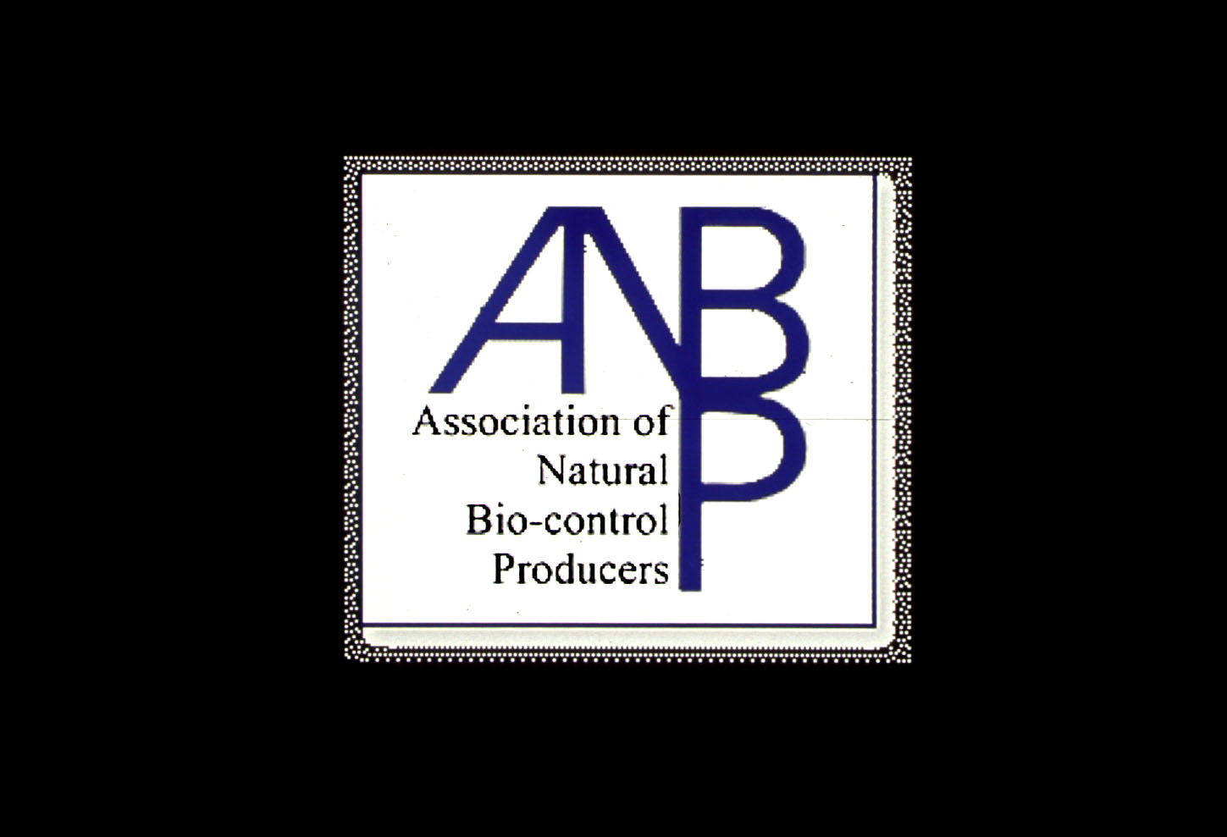


Biological Control Organizations with Commercial Affiliations
IOBC

Slide 6

ANBP's Objectives
Members of ANBP are expected to adhere to a code of ethics which encourages the highest standards in the production and marketing of natural enemies.
Strengthen the commercial natural enemy industry.
Promote research and education on the use of natural enemies.
Develop quality certification programs for natural enemies.

Slide 7
Guidelines for Purchasing and Using Commercial Natural Enemies and Biopesticides in Florida and Other States
N. C. Leppla and K. L. Johnson
More than 47 biological control companies provide nematodes, mites, insects, and bioinsecticides for pest management in Florida and the Southeast.
Nematodes are sold by 28 companies (5 species).
Predators are sold by 26 companies, 10 supply mites (10 species) and 16 supply insects (15 species).
Parasitic wasps are sold by 32 companies (23 spp.)

Slide 8
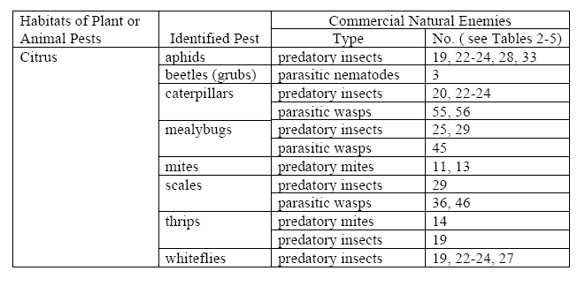
Table 1. Habitats, pests, natural enemies and reference number

Slide 9
Tables 2-7. Natural enemies and number of sources
Table 2- Nematodes (8)
Table 3- Predatory mites (10)
Table 4- Predatory insects (16)
Table 5- Parasitic wasps (23)
Table 6- Biopesticides (21)
Table 7- Companies and websites (47)

Slide 10
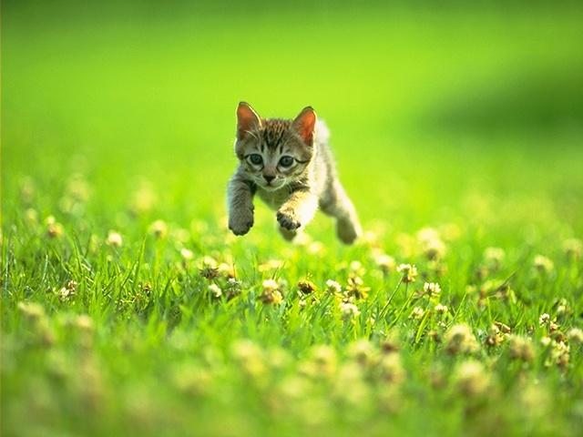
Predators!

Slide 11
Number, Size, Revenue and Species of North American Companies
Number = 49 producers and suppliers
Size = 10 employees average
Revenue = $20-25 million, 3 > $1.5 million
Species = 57 (+ 21 microbials)
5/20 producers >3 species
50% produce one species
Few new species

Slide 12
New Product Development

Slide 13
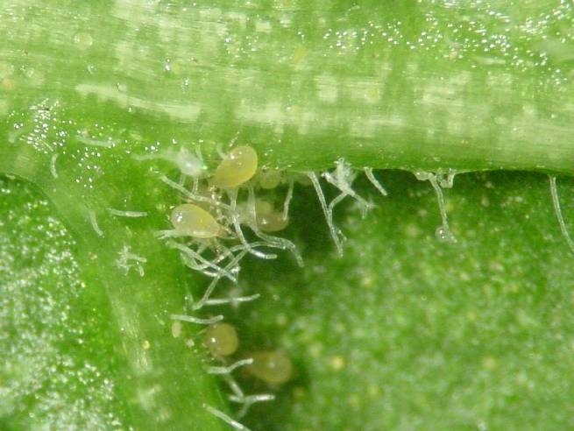
Amblyseius swirskii

Slide 14
Western Flower Thrips Control in Cucumbers
Mite Species

Slide 15
Bemesia tabaci Control on Hibiscus
Release dates
A. swirskii per plant
B. tabaci with A. swirskii
B. tabaci without A. swirskii

Slide 16
Amblyseius swirskii Effectiveness
Very high numerical response to availability of food
Highly efficacious against western flower thrips, greenhouse whiteflies and tobacco whiteflies
In combination with:
Orius spp. against western flower thrips
Whitefly parasites against whiteflies
P. persimilis or A. californicus against two-spotted spider mites
Good establishment on pollen
Whiteflies can substitute for pollen in peppers
Good results in North and South Europe
May replace A. cucumeris, depending on release permits

Slide 17
Chemical Pesticides Versus Biological Control:
Investment and Return
Investment
3
Sales
30 Billion
600 Million
Biological Control
Chemical Pesticides

Slide 18
Natural Enemy Sales Increases
Pesticide resistance
Transgenic crops
Loss of pesticides (regulatory)
New more selective pesticides
Cost of pesticides (registration)
Alien invasive species
Cropping systems (pollinators, organic)

Slide 19
Commercial Biological Control Needs
Expertise
New Markets & Products
Science and Technology
Improved rearing and release methods
Field tests to determine efficacy
Compatibility with pesticides
Taxonomic support
Quality control and customer service
Regulations

Slide 20
IPM Transition
Invasive Pest
Resistant Crop
Competitors
Natural enemies
Resistant varieties
Vulnerable Crop
Integrated pest management program:
Cultural practices
Scouting, ID of pests & NEs
Conservation of NEs
Augmentation of NEs
Reduced-risk insecticides
Resistance management
Pesticide program:
New insecticides
New formulations
New Application methods
Resistance management

Slide 21
What is IPM?
IPM is the coordinated use of pest and environmental information and available pest control methods…
to prevent unacceptable levels of pest damage by the most economical means…
with the least possible hazard to people, property and the environment.

Slide 22
IPM System
REDUCE RISK…
Pest outbreaks & disease epidemics
Environmental contamination
Human health hazards
Pest mgmt. costs
INCREASE…
Reliability
Sustainability
Chem
Biological Control
Cultural Methods

Slide 23
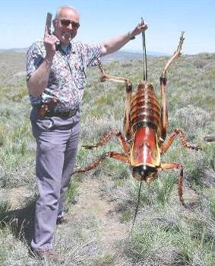
IPM Actions
Scouting
Diagnosis
Thresholds
Management
Evaluation

Slide 24
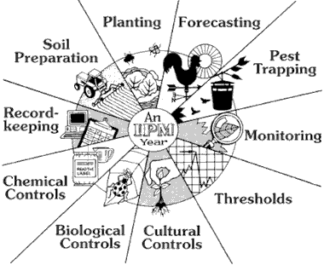
Evaluating IPM Practices

Slide 25

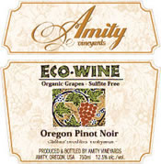

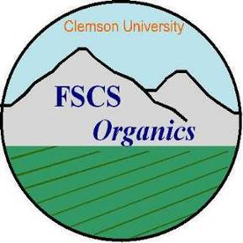





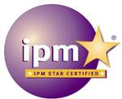


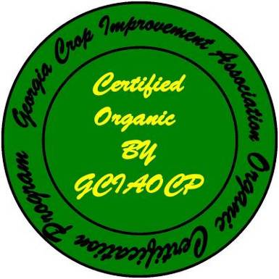

Eco-labels

Slide 26
Eco-labeling Components
3rd Party
Auditor
Certification
Eco-Label
Chain of
Custody
Standards
Education &
Outreach
Marketing
Notes:
An IPM system can be the nucleus of a sustainable agricultural program that is identified by an eco-label. The eco-label brands farm products so that they can be identified by consumers as raised according to standards of safety and sustainability. Compliance with these standards is enforced by third party auditor and there is a process for continuing education. The standards extend through the entire chain of custody to the consumer. Eco-labels are recognized in the marketplace and becoming more popular, especially for food products (consumers union).

Slide 27
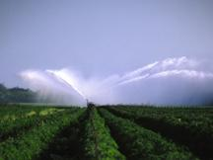
Sustainability of Agriculture
Economic profitability
Environmental health
Social and economic well-being

Slide 28

Information on Commercial Biological Control
http://ipm.ifas.ufl.edu

